Slide 1
Valuing and Storing Information
Databases part 1

Slide 2


Importance of precise data collection
Notes:
Click to watch video
Business decisions are only as good as the quality of the information used to make the decisions
You never want to find yourself using technology to help you make a bad decision faster

Slide 3


Slide 4
Announcements
Shifting from Knowledge-Based to Skills-Based Learning
Watch the videos in the lessons! (You may use the YouTube playback speed control as needed.)
I will do much more hands-on in the class sessions.
Use the TAs and the Lab!
More project-based assignments. Only three more quizzes!
Check the Schedule on LearningSuite every day
Create a free LucidChart account and experiment. You’ll be using it in the next lesson.
Office Hours:
Google Hangouts: Learning Suite – Content – Office Hours
Cameras are great! You can call if the computer doesn’t work.
Wednesdays from 6:00pm – 7:00pm - Thursdays from 4:30pm to 5:30pm
Subject to Change – always check LearningSuite
Midterm due Saturday!
45 minutes, 27 questions
No class on Monday: MLK Day Holiday!

Slide 5
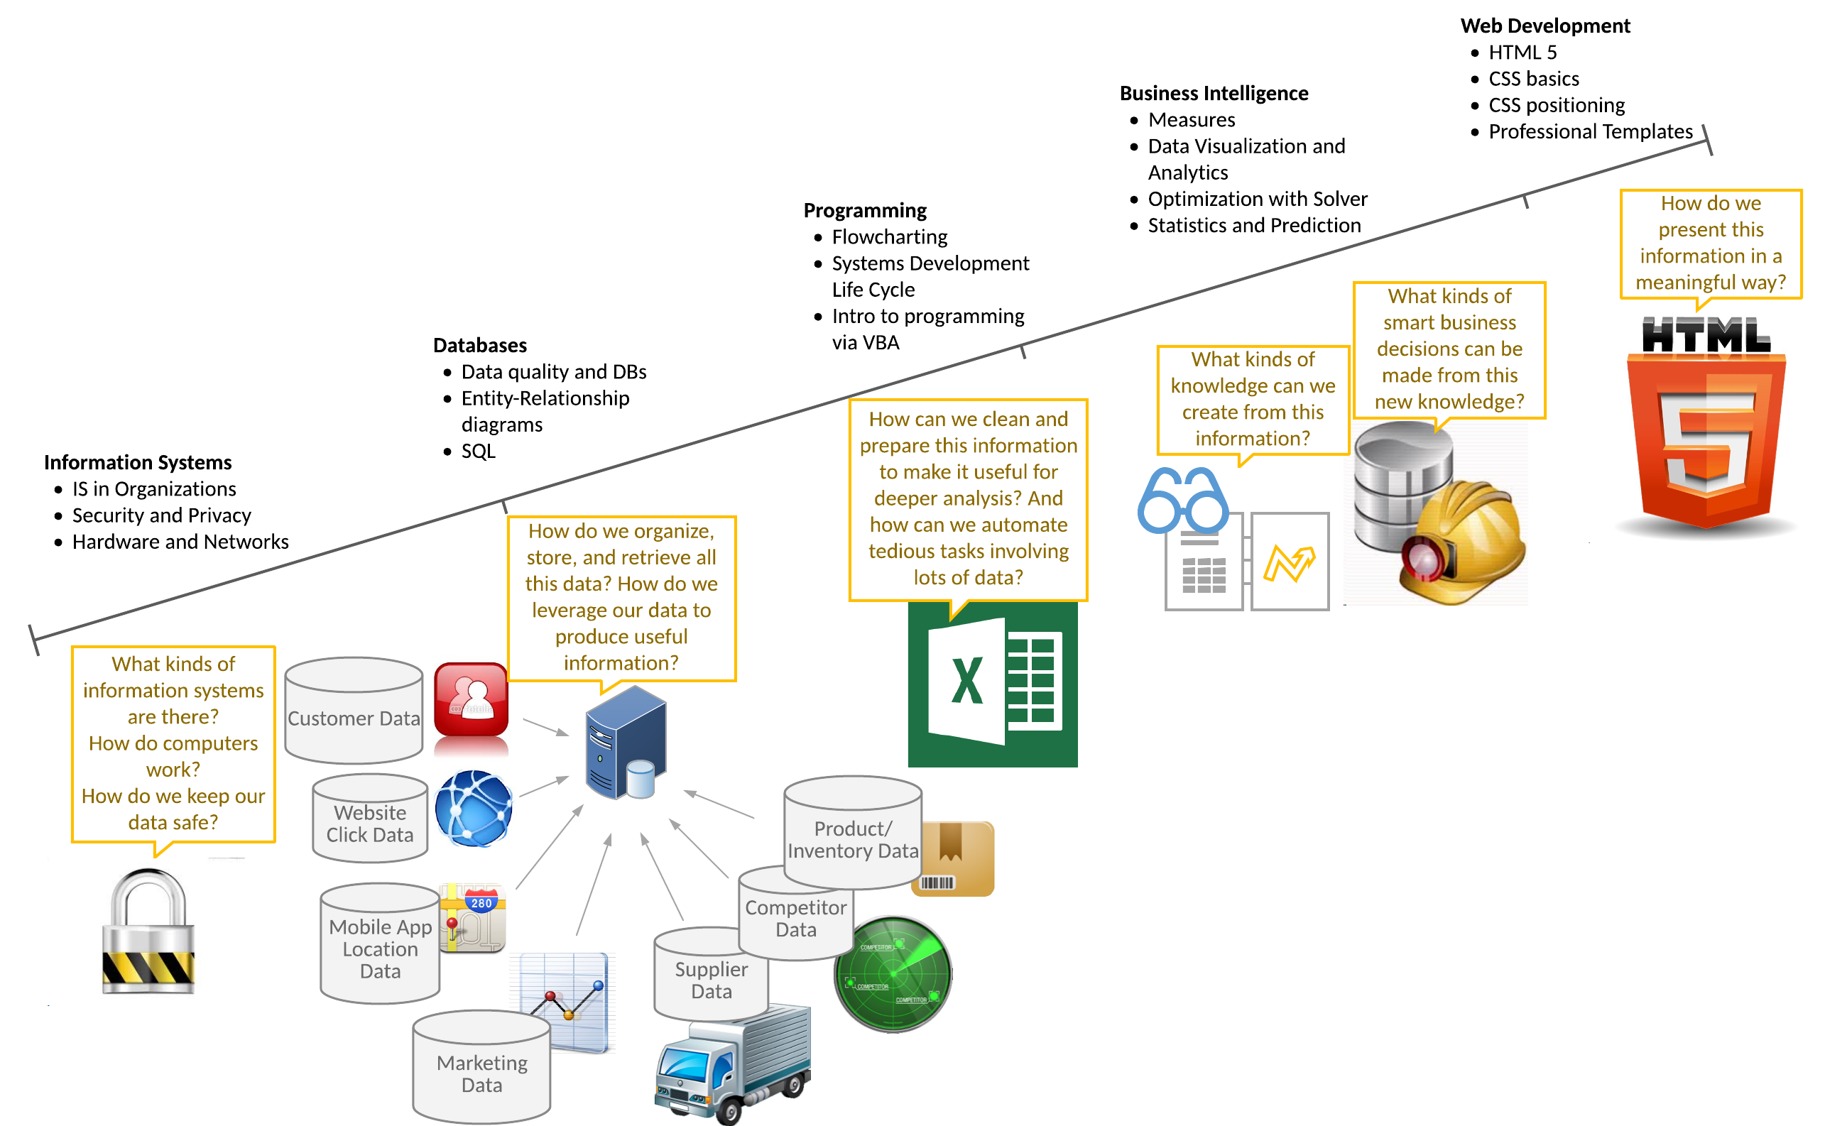
Class topics

Slide 6
Transactional Vs. Analytical
Transactional information
Encompasses all info used in a business process
Required to support performing operational tasks
Examples: What’s recorded during…
…an ATM transaction?
Date/time, amount, customer, account, location
…a customer checkout?
Items, quantities, payment method, date, clerk, customer (if possible)
…an airline reservation?
Flight number, seat number, payment method, customer info, etc.

Slide 7
Transactional Vs. Analytical
Analytical information
Encompasses all organizational information
Used to solve new/unstructured business problems, make ad-hoc (irregular) managerial decisions
Summarizes transactional information: Weekly sales by product, region, customer, etc.
Examples:
Website data: User click patterns, abandoned shopping carts, etc.
Mobile app data: Location data, preferences, settings, clicks
External data purchased from marketing firm: Consumer demographics and preferences
Supply chain data: Supplier info like quality, service, product ratings

Slide 8
Characteristics of high-quality information
Accuracy: Are all of the values correct?
Names spelled correctly?
Completeness: Is all or part of a value missing?
Does the address include a zip code?
Consistency: Calculations correct?
Does the sum of the line items = total value?
Uniqueness: Duplicate values?
Do we have the same customer listed twice?
Timeliness: Is the information current enough?
Do we have data updated hourly but need it minutely?
Notes:
Examples of violations of the characteristics of high quality information
Accuracy: misspellings, letters in phone numbers
Completeness : number missing from address, area code missing from phone number
Consistency : overall company sales not equal to the sum of the individual stores, total salary not equal to individual employees’ salary
Uniqueness : the same customer entered more than once
Timeliness : stock broker making decisions based on 20 minute delayed stock data

Slide 9
Got Issues?
What problems do you see in this data?
Completeness
Accuracy
IDs | Lname | Fname | Street | City | ST | Zip | Phone | Fax | Email
113 | Simpson |  | 742 Evergreen Terrace | Springville | OR | 12345 | (303) 777-1258 | (303) 777-5544 | hsimp@aol.com
114 | Simpson | Marge | 742 Evergreen | Springville | OR | 12345 | (303) 123-4567 | (303) 123-4567 | marge@com
115 | Simpson | Bart | 742 Evergreen Terrace | Springville | OR | 12345 | 879-5521 | 879-2213 | elbarto@msn.com
116 | Simpson | Bartholomew | 742 Evergreen Terrace | Springville | OR | 12345 | 554-9822 | 554-9821 | elbarto@msn.com
Uniqueness

Slide 10
Got Issues?
What problem do you see in this data?
Qty x Price should equal Total
OrderNum | Product | Qty | Price
11356 | Red Brick | 100 | $2.00
11356 | Cinderblock | 10 | $2.50
11356 | Cement bag | 2 | $30.00
11356 | Gloves | 1 | $15.00
11356 | Shovel | 2 | $20
OrderNum | Date | PaymentType | Total
11356 | 6/6/2013 | Visa | $220.75
11357 | 6/7/2013 | Cash | $980.50
11358 | 6/7/2013 | Check | $3700.00
11359 | 6/8/2013 | AmEx | $4525.00
Consistency: the order line items don’t equal the order total

Slide 11
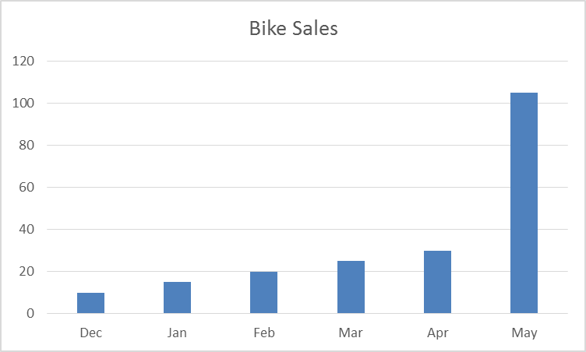
Got Issues? - Timeliness
???
You’re in charge of bike orders. It’s June 1st and you don’t have data for May sales yet. How many bikes do you order?

Slide 12

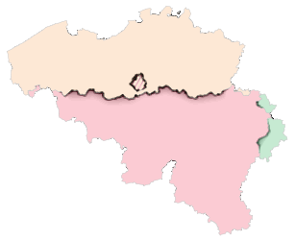

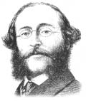
Timeliness of Information
Paul Julius Reuter understood the importance of the timeliness of information
Used carrier pigeons to transfer stock prices from Brussels and Aachen
Faster than train
Julius Reuter
(pronounced “Roiter”)

Slide 13
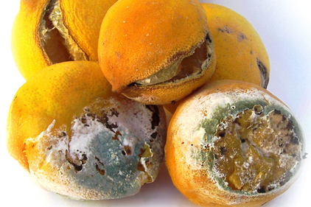
Data is like good food
Notes:
It has to be stored properly (organized in a database), and used timely, otherwise it is damaging

Slide 14


Garbage in Garbage out – Quality Matters

Slide 15


Database
What: A collection of data organized for search and retrieval
Why: To simplify and ensure quality of data in:
Data management
Data storage
Data retrieval
Who: Every organization of meaningful size
Where: Datacenters (local or on cloud)

Slide 16
Careers – DB Admin
Database administrators are responsible for all aspects of the DB; namely:
Overall design and coordination of the database
Development and maintenance of schemas
Development and maintenance of the data dictionary (Keys, Tables, Reports)
Implementation of the DBMS
Access rights
Report development

Slide 17
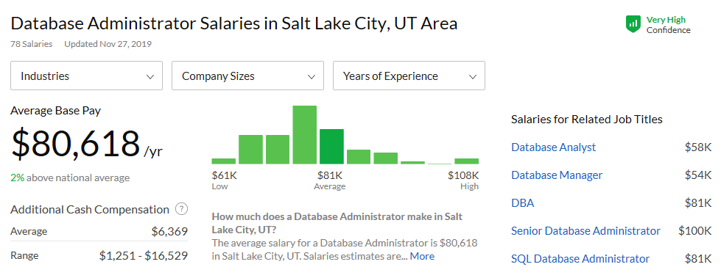
Glassdoor.com 15 January 2020

Slide 18
Components of Database Systems (DBMS)
Tables – Primary data structure
Columns define fields or attributes of data
Rows represent individual records
Queries – The process by which users request specific types of information
Forms and Reports – The user interface components on many systems (we will not teach this aspect in this class)

Slide 19

Some Basics of Databases
PK
Primary Key
Foreign Key
FK
Entities
Books
Authors
ID | Title | Auth
1 | Great Expectations | 5
2 | The Brothers Karamazov | 4
3 | Life on the Mississippi | 1
4 | Native Son | 3
5 | Atlas Shrugged | 2
Attributes
ID | LName | FName
1 | Twain | Mark
2 | Rand | Ayn
3 | Wright | Richard
4 | Dostoevsky | Fyodor
5 | Dickens | Charles
PK
FK
PK
A foreign key is just a primary key from a different table.
Notes:
PK means Primary Key
FK means Foreign Key
These link the tables together

Slide 20
Cardinalities 1:1 1:M M:M
Books
Authors
ID | Title | Auth
1 | Great Expectations | 5
2 | The Brothers Karamazov | 4
3 | Life on the Mississippi | 1
4 | The Fountainhead | 2
5 | Atlas Shrugged | 2
ID | LName | FName
1 | Twain | Mark
2 | Rand | Ayn
3 | Wright | Richard
4 | Dostoevsky | Fyodor
5 | Dickens | Charles
PK
FK
PK
One x can have at most, how many y?
Notes:
1:1 means that one book can only have one author
1:M means that one book can have many authors (or the other way around, but not both)
M:M means both: one book can be written by many authors and one author can write many books

Slide 21
The need for UNIQUE keys
Books
Authors
ID | Title | Auth
1 | Great Expectations | 5
2 | Life on the Mississippi | 1
3 | Invisible Man | 2
4 | Invisible Man | 4
5 | The Outsider | 3
ID | LName | FName
1 | Twain | Mark
2 | Ellison | Ralph
3 | Wright | Richard
4 | Wells | H.G.
5 | Dickens | Charles
PK
FK
PK
Notes:
Without unique author ID, we wouldn’t know which “invisible man” version this was (Ellison’s or Well’s)

Slide 22
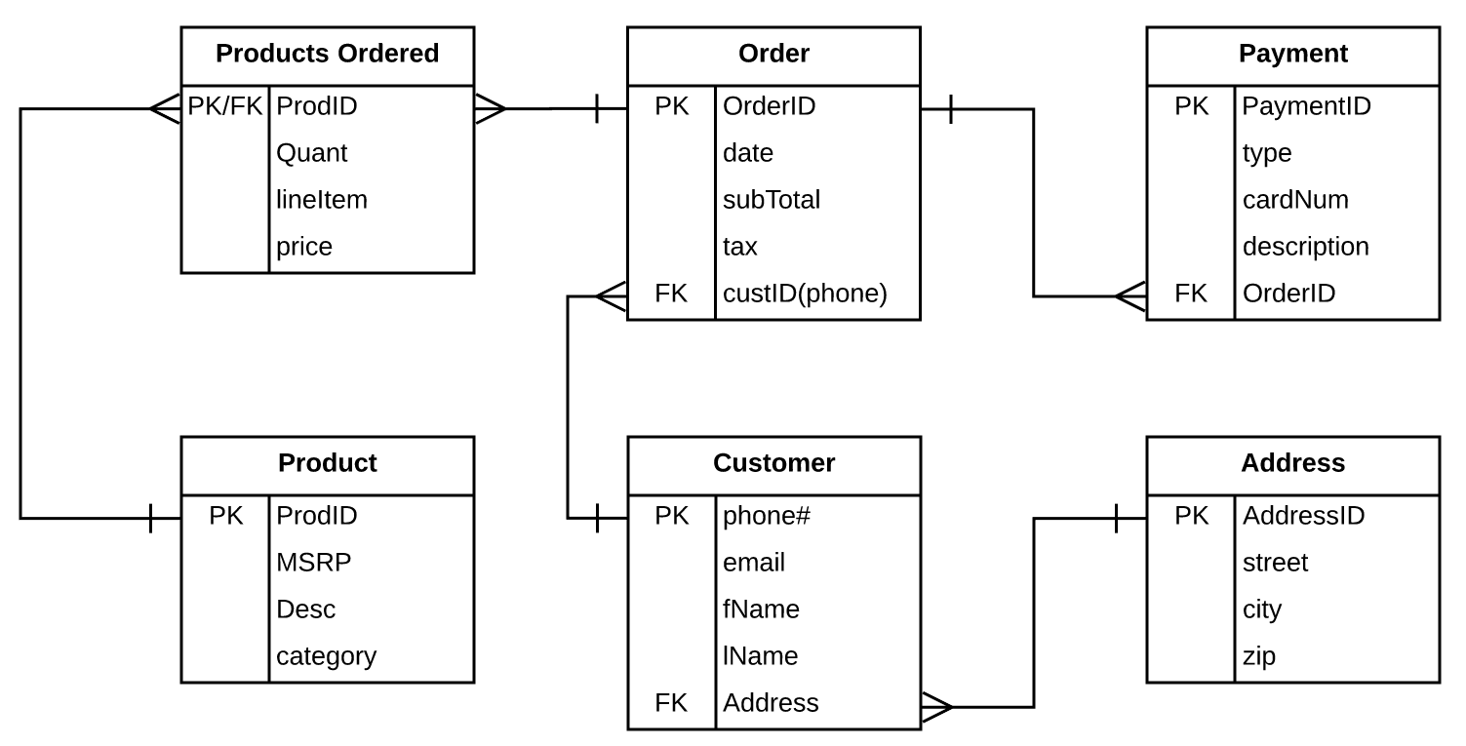
Relational Database Model

Slide 23
Goldstar (download from ME 3.1)
Organize the data into normalized tables
Introduce terms:
Entity
Attribute
Primary Key
Foreign Key

Slide 24

Quick Quiz: Reading Database Models
Customer
CustomerID(PK) | Name | Contact | Phone
23 | Dave's Sub Shop | David Logan | (555) 333-4545
43 | Pizza Palace | Debbie Fernandez | (555) 345-5432
765 | T's Fun Zone | Tom Repicci | (555) 565-6655
Order
OrderID(PK) | Order_Date | CustomerID(FK) | DistributorID(FK) | Distributor_Fee | Total_Due
34561 | 7/4/2017 | 23 | DEN8001 | $ 22.00 | $145.75
34562 | 8/6/2017 | 23 | DEN8001 | $ 12.95 | $ 67.95
34563 | 6/5/2017 | 765 | NY9001 | $ 29.50 | $249.50
Line_Item
OrderID(PK/FK) | Line_Item | ProductID(PK/FK) | Quantity
34561 | 1 | 12345AA | 75
34561 | 2 | 12346BB | 50
34561 | 3 | 12347CC | 100
34562 | 1 | 12349EE | 100
34563 | 1 | 12345AA | 100
34563 | 2 | 12346BB | 100
34563 | 3 | 12347CC | 50
34563 | 4 | 12348DD | 50
34563 | 5 | 12349EE | 100
Distributor
DistributorID(PK) | Distributor_Name
DEN8001 | Hawkins Shipping
CHI3001 | ABC Trucking
NY9001 | Van Distributing
Product
ProductID | Product_Desc | Price
12345AA | Coca-Cola | $ 0.55
12346BB | Diet Coke | $ 0.55
12347CC | Sprite | $ 0.55
12348DD | Diet Sprite | $ 0.55
12349EE | Vanilla Coke | $ 0.55
Notes:
How many orders have been placed for T’s Fun Zone?
How many orders have been placed for Pizza Palace?
How many line items are included in Dave’s Sub Shop’s two orders?
Who is responsible for distributing Dave’s Sub Shop’s orders?
Which products are included in Order 34563?

Slide 25
DB vs. Spreadsheet
Why not just use a spreadsheet?
Limited number of rows and columns
Excel 2016+ has 1,048,576 rows by 16,384 columns,
Only one user can access the spreadsheet at a time
Users can view all information in the spreadsheet
Users can change all information in the spreadsheet
Scalability and Performance
EXCEL IS NOT A (good) DATABASE!!!

Slide 26
Relational Database Advantages
Database advantages from a business perspective include
Increased flexibility
Increased scalability and performance
Reduced information redundancy
Increased information integrity (quality)
Increased information security
Details up next
Notes:
All of the above are discussed in the following slides:
A good way to explain databases is to compare them to spreadsheets
What are the limitations when using a spreadsheet?
Limited number of rows and columns (Excel - 65,536 rows by 256 columns; Excel 2007 – increased to 1,048,576 rows by 16,384 columns, http://bit.ly/cW6ISM) Once you use more than 65,536 rows you have outgrown your spreadsheet
Only one users can access the spreadsheet
Users can view all information in the spreadsheet
Users can change all information in the spreadsheet
All of the disadvantages associated with a spreadsheet are fixed when using a database
These advantages are discussed in detail over the next several slides

Slide 27
Increased Flexibility
A well-designed database should:
Handle changes quickly and easily
Have only one physical view
Have multiple logical views (sometimes called “virtual views”)
Notes:
The separation between logical and physical views is what allows each user to access database information differently
What would happen if a new database called “RealData” hit the market and allowed only one logical view?
The “RealData” database simply would never sell. With only one logical view every person in an entire organization would have the same view
Define two database views for your school’s student database (one for students, and one for instructors)
What does the student view display when a student accesses the school’s student database?
Courses enrolled
Grades
Tuition
Credits for graduation
What does the instructor view display when an instructor accesses the school’s student database?
Courses teaching
Students in each course
Payment information
Vacation time

Slide 28
Reduced Information Redundancy
Databases reduce information redundancy
Inconsistency is one of the primary problems with redundant information
Position Title | Education Required | Minimum Salary | Maximum Salary
Trainee | 2 year degree | $25,000 | $40,000
Manager | 4 year degree | $50,000 | $150,000
Account Rep | 4 year degree | $25,000 | $75,000
Trainee | 2 year degree | $18,000 | $25,000
Spreadsheet
Position
Pos ID (PK) | Position Title | Education Required | Min Salary | Max Salary
1 | Account Rep | 4 year degree | $25,000 | $75,000
2 | Manager | 4 year degree | $50,000 | $150,000
3 | Reg Manager | 6 year degree | $75,000 | $250,000
4 | Trainee | 2 year degree | $18,000 | $25,000
Database
Notes:
One of the primary goals of a database is to eliminate information redundancy by recording each piece of information in only one place
This is a good time to tie the discussion back to the material in the previous slides on low quality information.
Recall what happens when a single customer is stored twice with different phone numbers, addresses, or order information in a single database

Slide 29
Increase Information Integrity (Quality)
Salary must fall within min/max
Education requirements enforced
No other types of positions allowed in system
Position
Pos ID (PK) | Position Title | Education Required | Min Salary | Max Salary
1 | Account Rep | 4 year degree | $25,000 | $75,000
2 | Manager | 4 year degree | $50,000 | $150,000
3 | Reg Manager | 6 year degree | $75,000 | $250,000
4 | Trainee | 2 year degree | $18,000 | $25,000
Notes:
Relational integrity constraint
Business-critical integrity constraint
Can you define two relational integrity constraints for an ordering system?
Users cannot create an order for a nonexistent customer
An order cannot be shipped without an address
Can you define two business-critical integrity constraints for an ordering system?
Product returns are not accepted for fresh product 15 days after purchase
A discount maximum of 20 percent

Slide 30
Increased Information Security
Information is an organizational asset and must be protected
Databases offer several security features including:
Password
Access Levels (who can view)
Access Controls (who can edit)
Remember: Authentication and Authorization
Notes:
Why you would want to define access level security?
Access levels will typically mimic the hierarchical structure of the organization and protect organizational information from being viewed and manipulated by individuals who should not have access to the sensitive or confidential information
Low level employees typically have the lowest levels of access
High level employees typically have access to all types of database information
For example: You would not want analysts viewing all salary information for the entire company - in general:
Analysts can usually only view their own salary
Managers have higher access and can view the salaries of all their team members, but cannot view other managers’ salaries
Directors can view all of their managers’ and analysts’ salaries, but not other directors’ salaries
The CFO and CEO can view every employee’s salary

Slide 31


Database Design
Let’s create our own relational DB diagram for the NFL using LucidChart.
What are the entities?
What are the attributes?

Slide 32
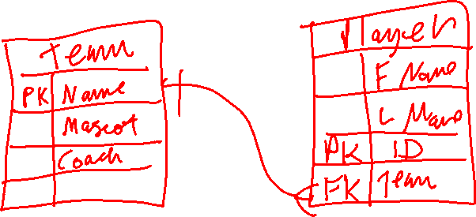
Database Design for NFL: Entity-Relationship Diagram (ERD)

Slide 33
Data Vocabulary
Spreadsheet | Database | Entity-Relationship
Workbook | Database | ERD (Diagram)
Worksheet | Table | Entity
Row | Record | Instance
Column | Field | Property

Slide 34
Midterm Review
Internet Structure
Local Area Network (LAN), Wide Area Network (WAN)
Internet, World-Wide-Web, “The Cloud”
Virtual Private Networking (VPN)
Internet Addresses (IP Addresses)
CIA Triad
Confidentiality, Availability, Integrity
Roles
Hacker, Malicious Insider, Non-Malicious Insider
Authentication and Authorization
Authentication Types
Something You Know, Something You Have, Something You Are
Types of Threats
Attacks, Failures, Natural Disasters
Network Sniffing, Password Guessing, Distributed Denial of Service (DDoS)
Social Engineering, Phishing
Malware
Lost Credentials, Accidental Deletions
Types of Malware
Virus, Worm, Trojan Horse
Protections
Password quality and management
Software Updates and Security Patches
Encryption, Checksums
Backups, Reundancy
Firewalls
Virus Scanning Software
Information Systems
Organizations, People, Information Technology
Types of Data Systems
Transaction Processing Systems (TPS)
Management Information Systems (MIS)
Enterprise Resource Planning (ERP)
Supply Chain Management (SCM)
Decision Support Systems (DSS)
Executive Information Systems (EIS)
Legacy Systems
Financial and Managerial Accounting
Customer Relationship Management (CRM)
Information and Data
Computer Data
Binary, Bit, Byte
Kilobyte, Megabyte, Gigabyte, Terabyte
CPU Architecture
Number of Cores, Clock Speed, Hyperthreading
Types of memory
Primary, Secondary
Cache, Main, Disk, Solid-State Drive (SSD), Flash
RAM, ROM
Network Media
Coax, Twisted Pair, Fiber
Networking Protocols
TCP/IP, HTTP, SMTP, etc.

Slide 35
Fill out the survey!
Learning Suite – Content – Polls – “How was class today?”
Chapter 3: Entity-Relationship Diagrams and SQL
Quiz on 3.1 due by 11:59 Today
Exam due by 11:59 Saturday!
27 Questions, 45 Minutes

